Slide 1
MMA 867: Predictive Modelling
Team Chown

Slide 2
AGENDA:
Walmart’s Challenge
Business Landscape
Promotional Effect
Analytical Insights
Approach
Recommendation & Impact

Slide 3
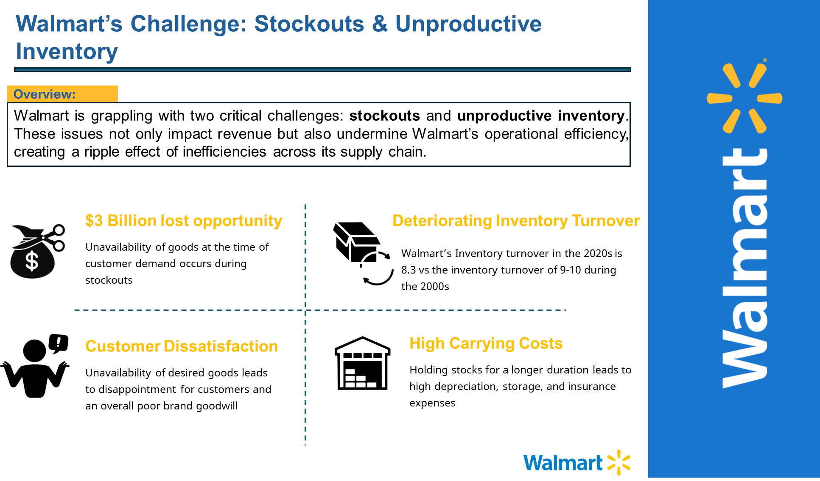

Slide 4
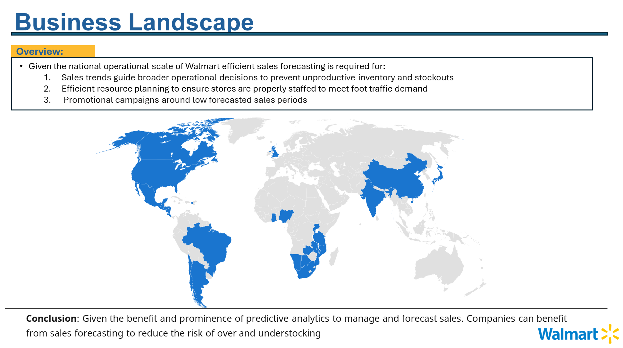
Notes:
https://biztechmagazine.com/article/2024/02/3-ways-machine-learning-changing-retail-better

Slide 5
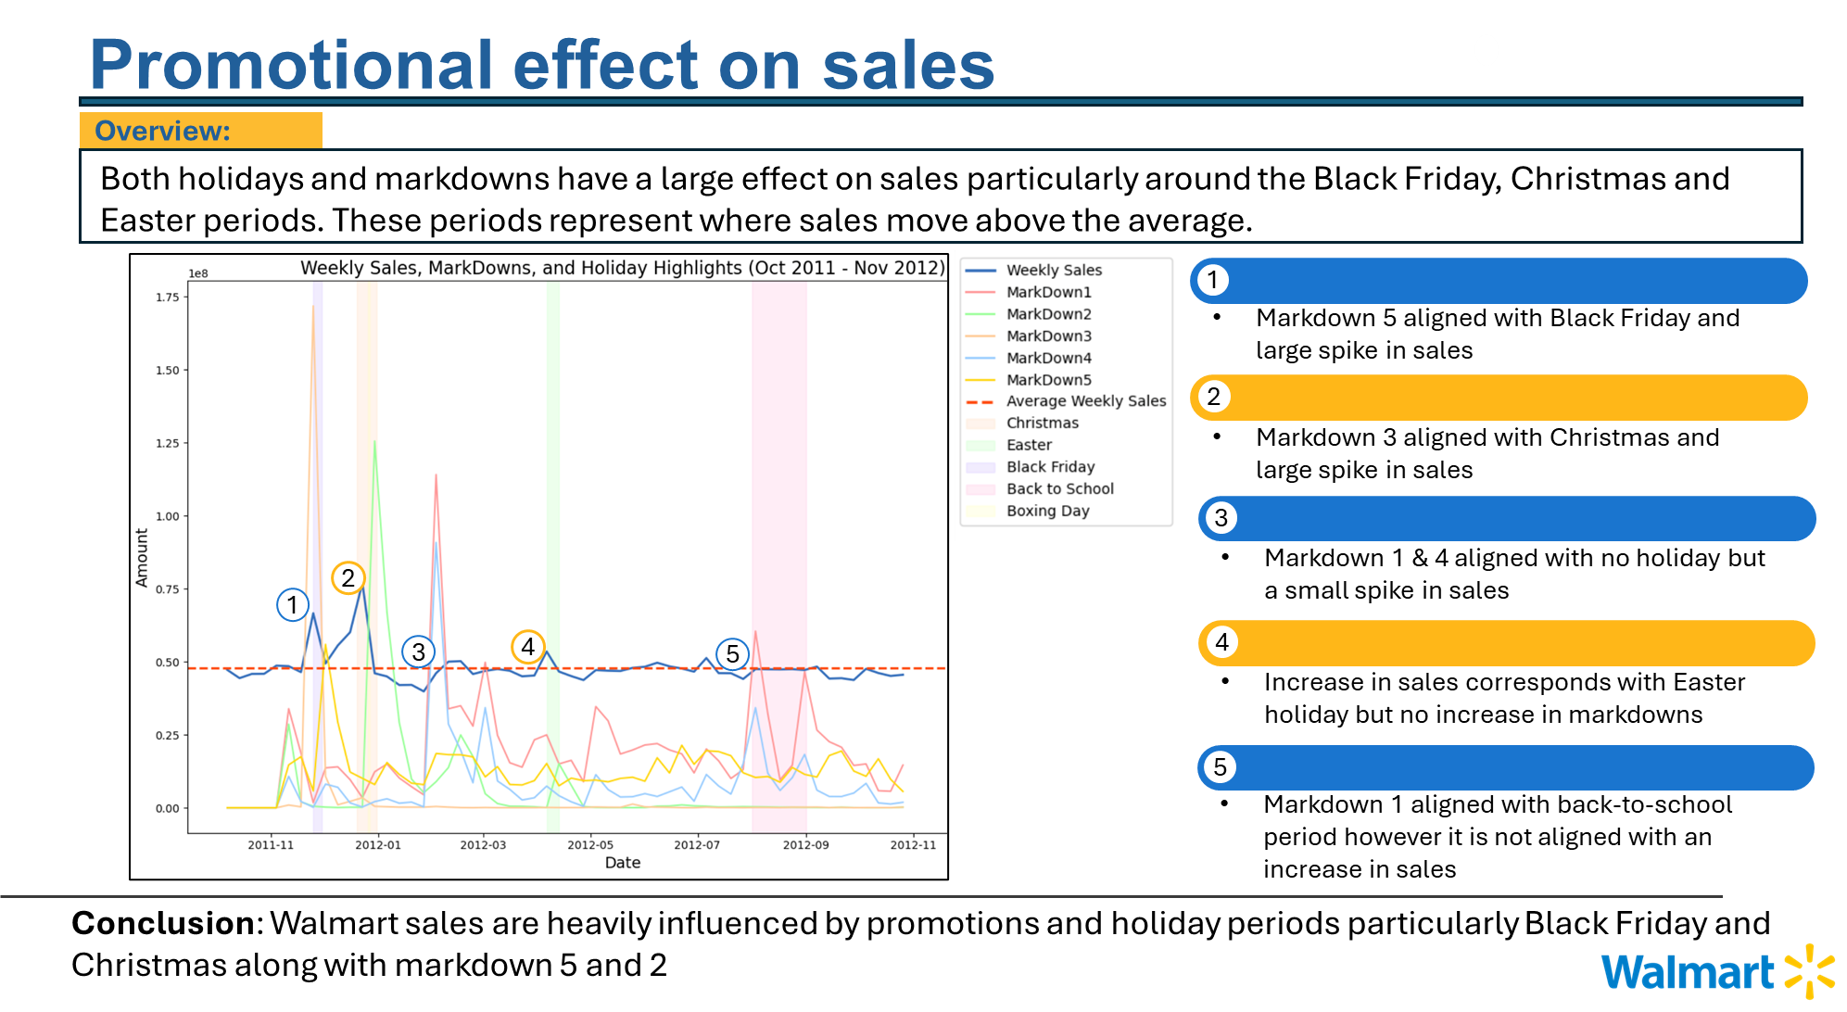

Slide 6
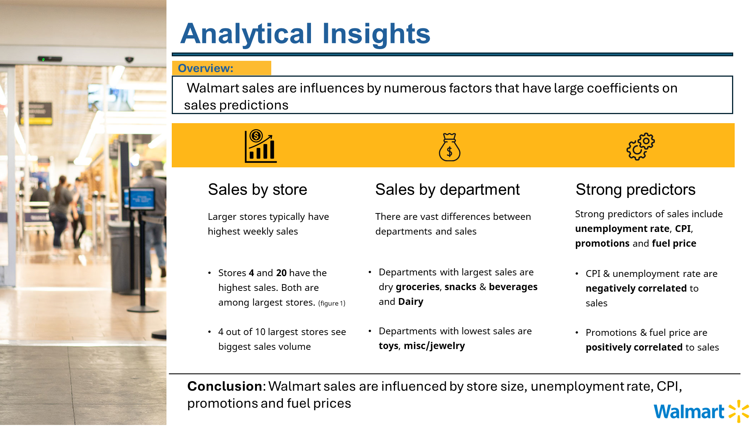

Slide 7
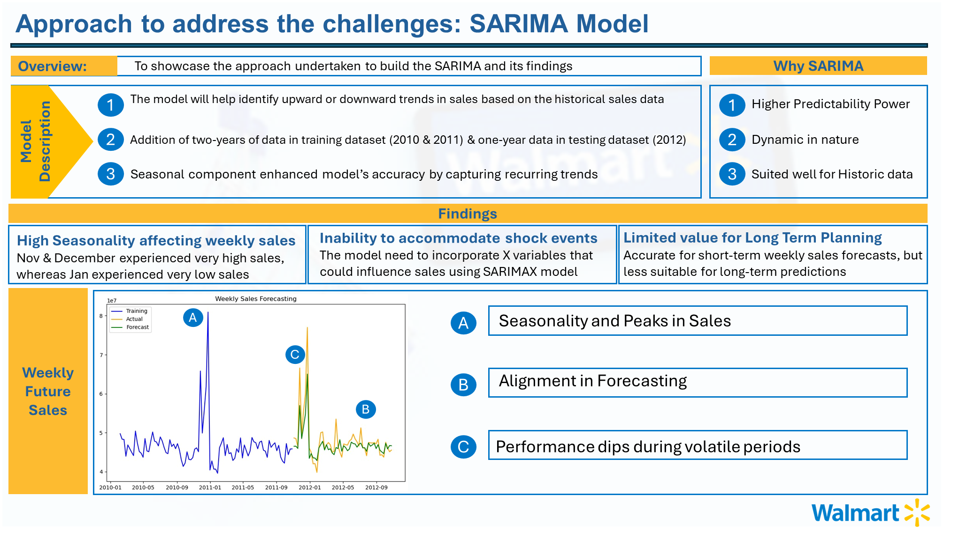

Slide 8
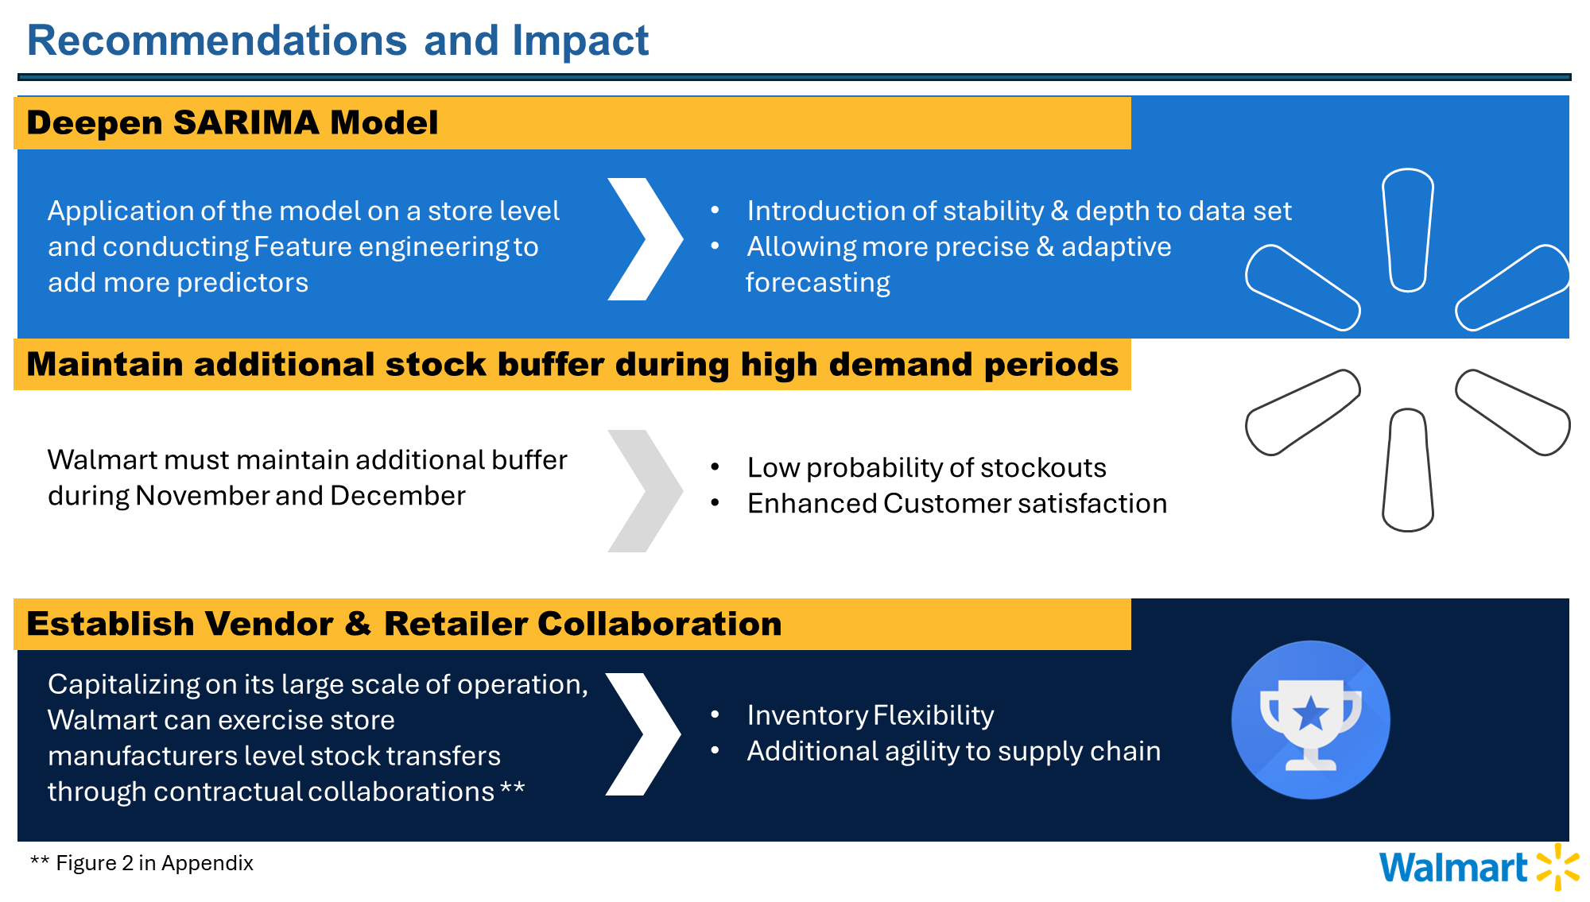

Slide 9
THANK YOU

Slide 10
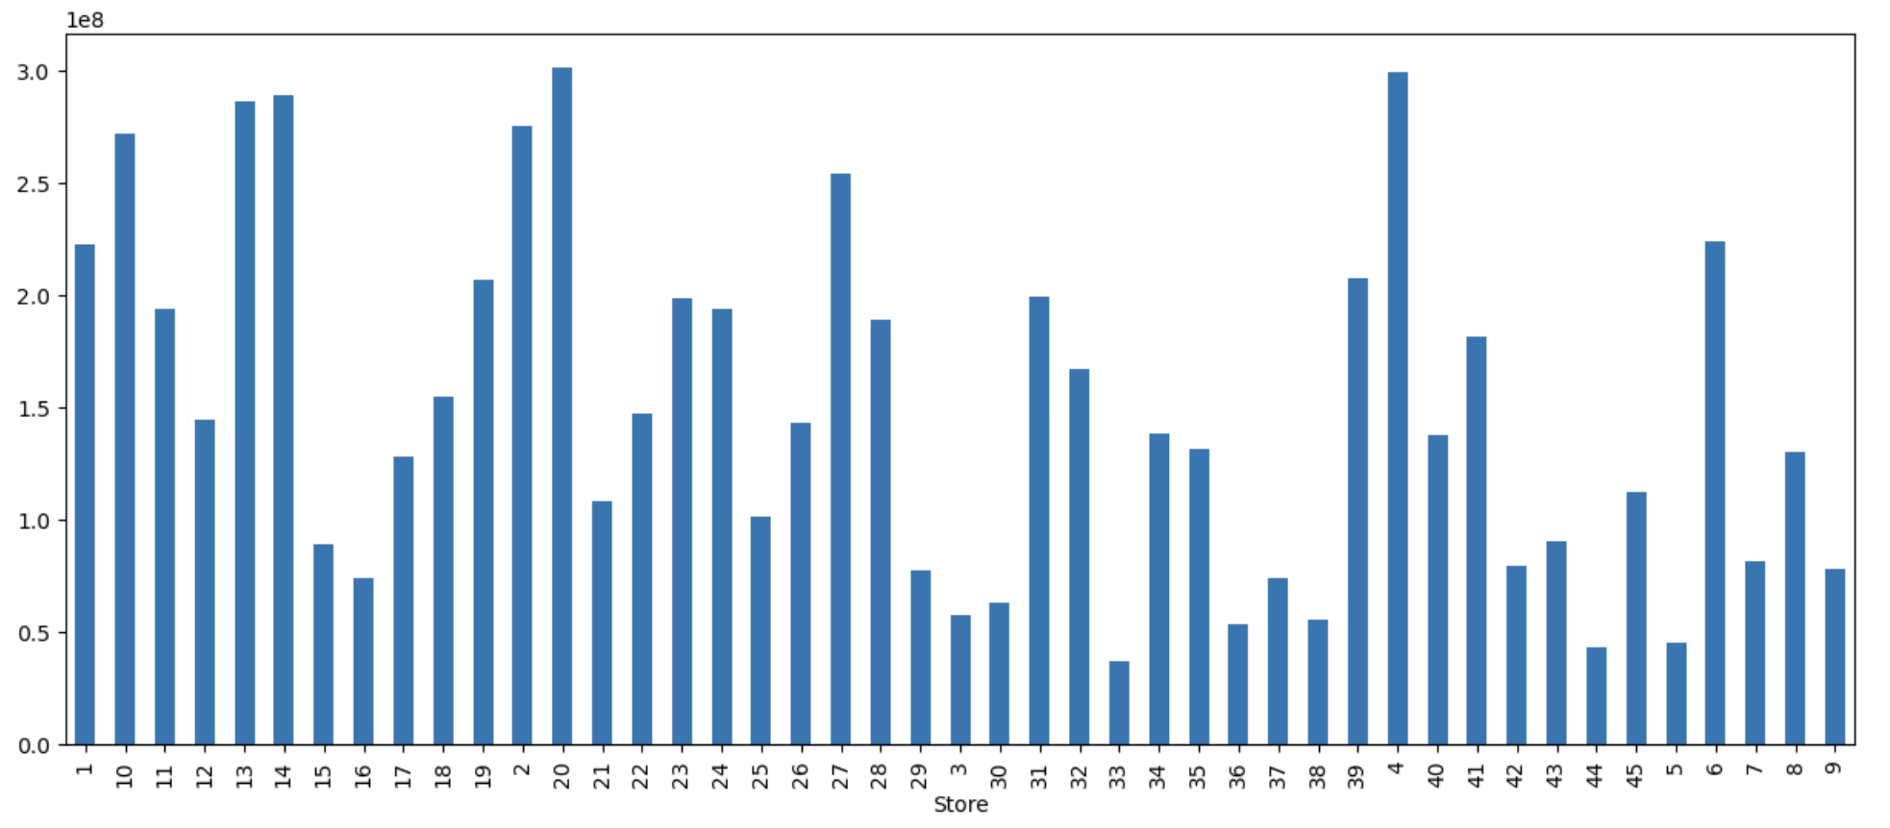

Appendix
Figure 1 (Weekly sales by store number)

Slide 11

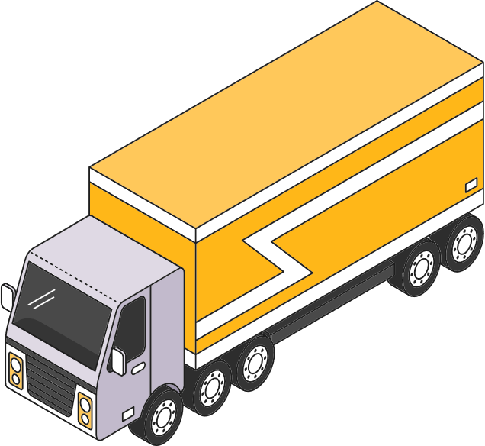

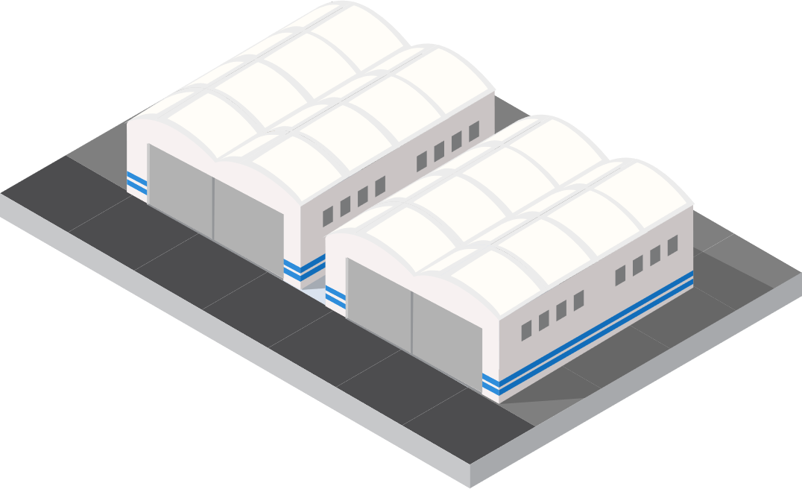
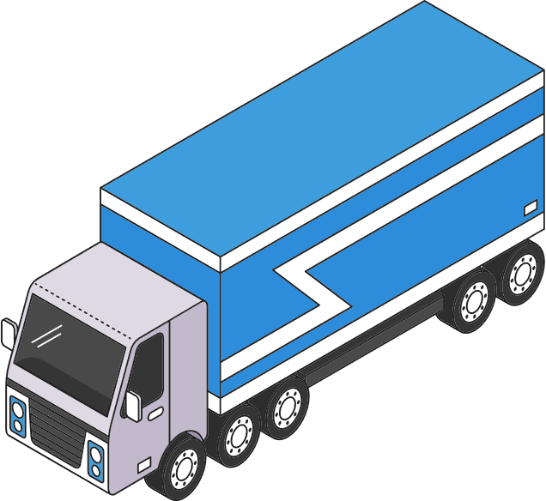


Figure 2
Supply Chain
Of Walmart
Manufacturer
Retail Store
Distribution Centre
Manufacturer
Retail Store
Satellite System
Manufacturer
Company Headquarters
Retail Store

